Slide 1
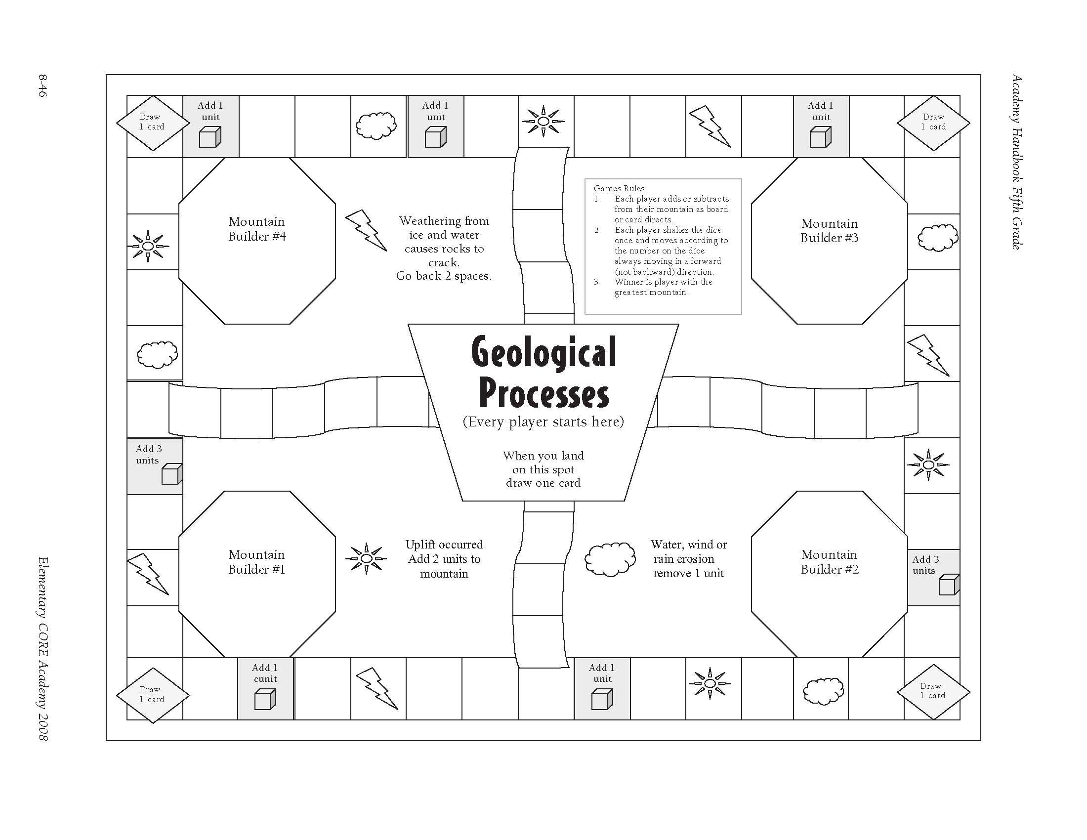
Draw 2 Cards
Draw 1 card
Draw 1 card
Draw 1 card
Draw 1 card
Draw 1 card
Draw 1 card
Draw 1 card
Draw 2 Cards
Draw 1 card
Game Rules:
1. Each player adds or subtracts from their mountains as the board or card directs.
2. Each player rolls the die and moves according to that number in the direction of the arrows.
3. The winner is the person with the greatest mountain when the teacher calls time.
Draw 1 card
Place Cards Here
Draw 1 card
Draw 1 card
Draw 1 card
Draw 1 card
Draw 1 card
Draw 1 card
Discard Cards Here
Draw 1 card
Draw 1 card
Draw 2 Cards
Draw 1 card
Draw 1 card
Draw 1 card
Draw 1 card
Draw 1 card
Draw 1 card
Draw 1 card
Draw 1 card
Draw 2 Cards

